Slide 1
Data Analysis Process
Startup Analysis

Slide 2
Team Introduction
Team - 13
• Urwa Maqsood — Team Lead (urwa22maqsood.apsaican@gmail.com)
• Karthikeya Buddula — Project Manager (karthikeyabuddula1359@gmail.com)
• Niveditha Makam — Project Manager (niveditha.makam29@gmail.com)
• Akshitha Thatla — Project Lead (akshitha16thatla@gmail.com)
• Ankitha Kontemukkula — Project Scribe (kpreethi181204@gmail.com)
• Sabbir Rahman — Project Scribe (sabbirrahmanleon@gmail.com)

Slide 3

Objectives
To create a master table that merges all relevant datasets into one integrated view.
To enable easy querying and reporting for:
Cohort-wise learner profiles.
Opportunity engagement statistics.
Demographic and academic analytics.
To improve data accessibility and decision-making for program administrators and analysts.
Problem with dataset
Scattered data made it hard to track learners, analyze cohorts, and extract insights efficiently.

Slide 4
Data Collection
Datasets Used:
user_data (learner background)
cohort_data (cohort timelines)
opportunity_data (applications and status)
learner_opportunity_data (application/enrollment metadata)
cognito_data (user demographics)
marketing_campaign_data (ad performance)
Sources: Internal platform exports

Slide 5
Data Processing
Set up database & schemas setup in PostgreSQL
Cleaned inconsistent formats and nulls
Matched cohorts using “assigned_cohort ↔ cohort_code”
Merged all data into a master table using learner_id and opportunity_id
Converted timestamps and ensured relational integrity

Slide 6
Master Table Creation
1. Database & Schema Setup
Created PostgreSQL database and tables
Final destination: master_enrollments table
Constraints & indexes added for performance
2. Data Loading (CSV → PostgreSQL)
Used COPY command to import CSVs
Handled data quality issues:
ENCODING = 'LATIN1' for special characters
Replaced string "NULL" with SQL NULL
Ensured header-column name alignment

Slide 7
Master Table Creation
3. Data Transformation (Stored Procedure)
Procedure: load_master_enrollments
Tasks performed:
Joins across 6 datasets using keys
Removed duplicates using ROW_NUMBER()
Converted UNIX timestamps to TIMESTAMP
Fuzzy-matched campaign & opportunity names using ILIKE
Normalized fields (trimming, capitalization)

Slide 8
Data Quality Report
Duplicate enrollment IDs: Used ROW_NUMBER() to keep only the most recent enrollment per learner
Mixed casing: Used LOWER(), TRIM(), INITCAP() functions to standardize text
"NULL" as string: Replaced both during import and again after loading
Encoding problems: Used ENCODING = 'LATIN1' in COPY command
Mismatched schemas: Aligned table definitions with actual structure found in the CSVs manually

Slide 9
Dashboard Building
Built interactive dashboards using Looker Studio
Visualized:
Learner demographics
Application trends by cohort
Status distributions
Time-based insights

Slide 10
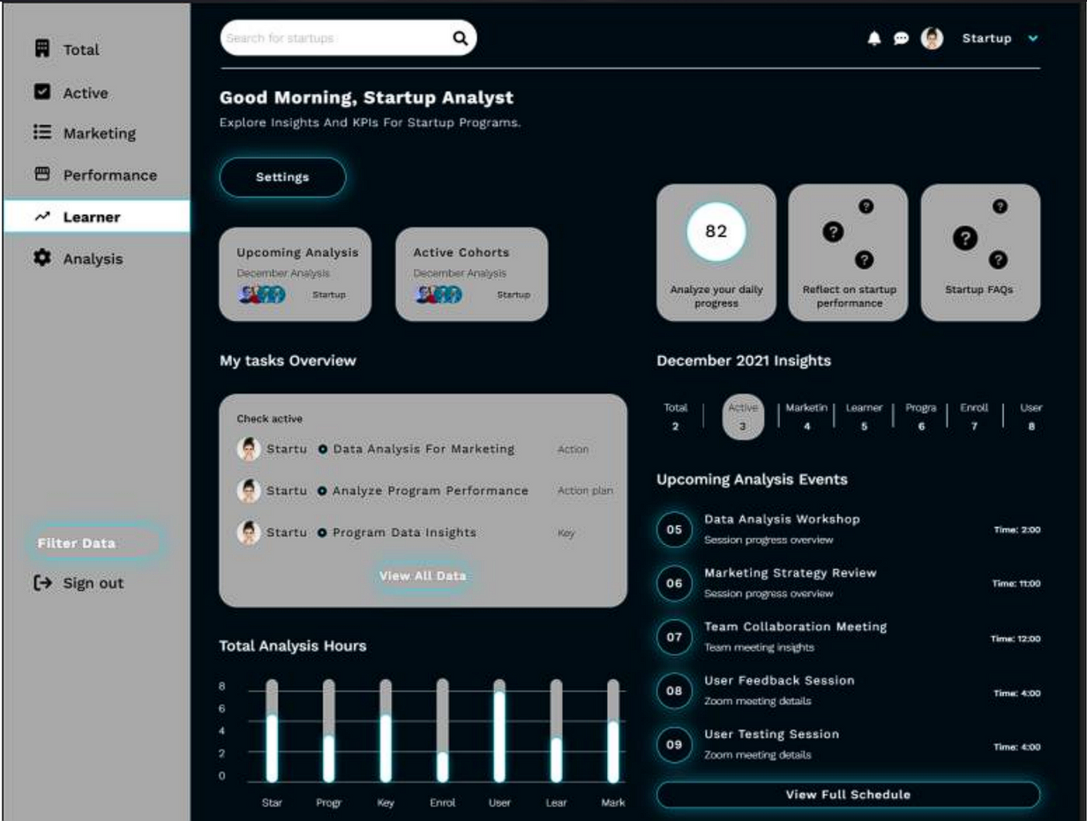
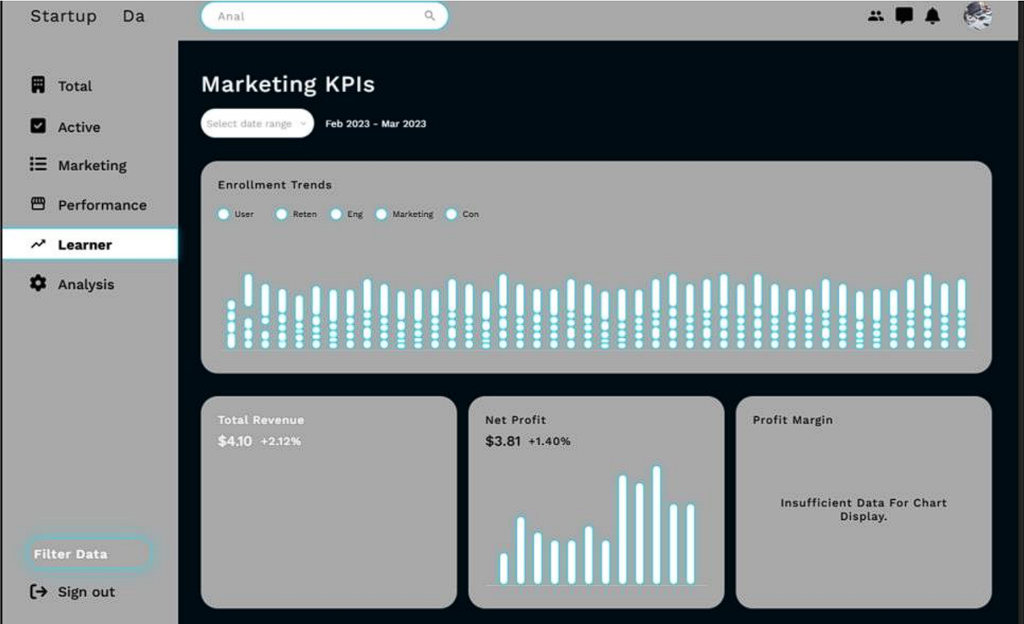
Wireframing

Slide 11
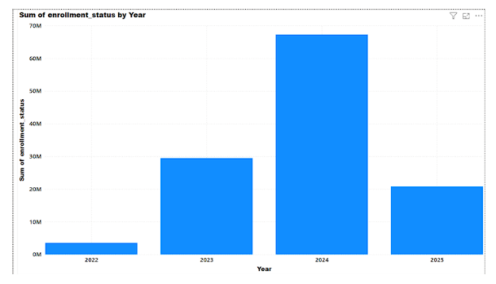
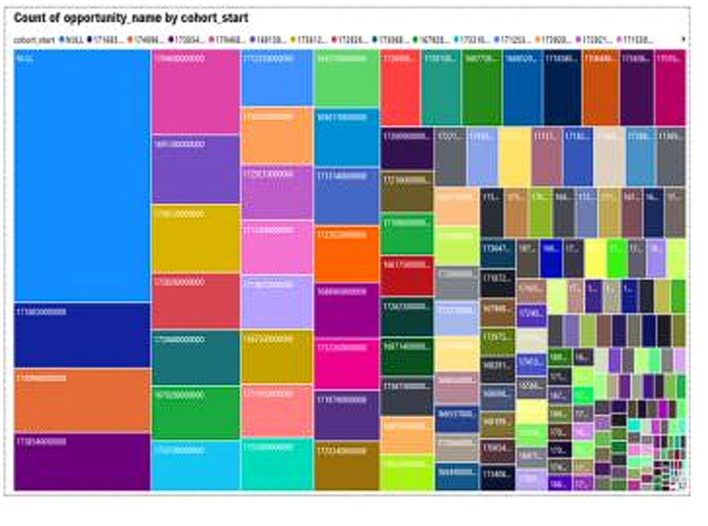
Key Insights from dashboard
Total Enrollment Status by Year
Total Opportunity by Cohort Code
Tracks Growth: Highlights year-on-year program expansion, signaling platform scalability and market reach.
Informs Strategy: Supports data-driven decisions for marketing, budgeting, and resource allocation based on historical enrollment patterns.
Immediate visual hierarchy, allowing stakeholders to identify trends at a glance
Easy comparison across cohorts, highlights patterns in cohort engagement and opportunity availability.
Decision making for resource allocation

Slide 12
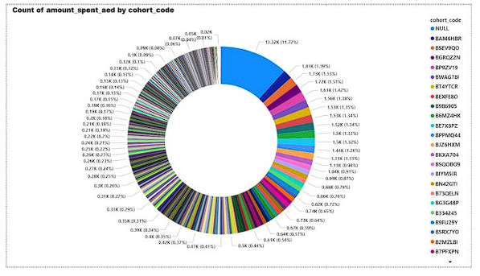
Total Amount Spent by Cohort Code
Immediate snapshot of which cohort has the highest or lowest spending.
Program administrators can assess whether funds are distributed efficiently.
Helps stakeholders quickly grasp spending trends.

Slide 13
Recommendations
Improve Resource Allocation:
Assess underrepresented cohorts and redistribute resources effectively.
Enhance Decision-Making with Trend Analysis:
Use historical enrollment trends to optimize program scaling and outreach.
Optimize Data Visualization for Accessibility:
Develop interactive dashboards and refine visual clarity for better insights.
Strengthen Communication & Reporting:
Use storytelling techniques and create regular reports for leadership teams.

Slide 14
Thank You

